Slide 1
IBM University Engagement Project Submission
“Exploring the Power of Agentic AI with IBM Cloud and Orchestrate”

Slide 2

Project Tile –
[College Admission Agent]
Domain of Project –
[ Education | Agentic AI ]
Student Name | Recent Passport Photo | Email ID | Mobile number
Tammana Kameswari Amulya |  | 2420030434@klh.edu.in | 9581581982

Slide 3
Problem Statement – College Admission Agent
Problem Statement : College Admission Agent
The Challenge
Every admission cycle, thousands of prospective students struggle to get clear, timely answers about
eligibility, courses, fees, scholarships, hostel life and the admission process — information that is often scattered across outdated PDFs, crowded helplines and inconsistent counselor advice.
The Objective
Build an AI-powered College Admission Agent that gives every student instant, accurate, 24/7 guidance on their admission journey. The solution should:
Instant Eligibility & Course Guidance – Answer questions on eligibility, course structure, duration and
seats using real admission data.
Transparent Fee & Scholarship Info – Provide itemized fee breakdowns and match students to scholarships they may qualify for.
Document Upload & Review – Let students upload admission documents (marksheets, certificates) for AI-assisted verification.
Guided Application Submission – Let students apply directly for a course or scholarship and receive a trackable reference number.
Multi-Agent System –
Admission Knowledge Agent (answers eligibility, hostel, placement and process questions)
Course & Scholarship Recommendation Agent (matches students to relevant programs and awards)
Document Verification Agent (reviews uploaded admission documents via a RAG pipeline)
Application Agent (captures and confirms course/scholarship applications)
Admin Dashboard (future scope) – Track submitted applications and admission funnel in real time.

Slide 4
Proposed Solution -
Proposed Solution: AI-Powered College Admission Agent
The proposed solution is a conversational AI-powered College Admission Agent built with React, Flask, and a
REST API — architected so IBM watsonx.ai's Granite models can be dropped in as the reasoning engine with a single function swap, requiring no frontend changes.
At its core, the solution is designed around a Retrieval-Augmented Generation (RAG) pipeline that will fetch
accurate answers from official admission PDFs and brochures uploaded by the institution. This data will be chunked, embedded, and stored in a vector database, enabling the system to ground its answers in real documents rather than guesses.
The system consists of four key logical agents:
Admission Knowledge Agent answers eligibility, hostel, placement, fee and process questions using structured admission data.
Course & Scholarship Recommendation Agent matches a student's profile to relevant courses and scholarships based on eligibility and interests.
Document Verification Agent reviews uploaded admission documents (marksheets, certificates) and will flag missing or
inconsistent information once the RAG pipeline is fully connected.
Application Agent captures a student's course or scholarship application and issues a unique reference number for tracking.
The solution includes a modern, responsive dashboard (built with React and Tailwind CSS) featuring a ChatGPT-style Admission Chat, a searchable Course Finder, a Scholarship explorer, and a transparent Fee Structure page.
Flask powers the REST API layer today, while the architecture is IBM watsonx.ai-ready: generate_ibm_response() in
rag.py is the designated integration point for Granite models, and retrieve_relevant_context() is already scaffolded for the RAG retrieval step.
Overall, this solution delivers an end-to-end intelligent admissions assistant that replaces scattered PDFs and helpline queues with instant, personalized, always-on guidance.

Slide 5
Technology Used
IBM watsonx Orchestrate – Hosts and runs the College Admission Agent, built with the no-code Agent Builder and tested live via the Talk-to-Agent chat interface
AI Model – Currently configured with GPT-OSS 120B on the Orchestrate platform; IBM Granite models are natively supported and can be selected as an alternative reasoning engine.
RAG (Retrieval-Augmented Generation) – Fetches real admission document content first, then generates grounded, trustworthy answers.
React.js + Tailwind CSS + Flask (REST API) – Powers the chat UI, course finder, scholarship explorer, fee structure and application flow.
Vector Database (FAISS/Chroma) – For RAG-based admission document retrieval from uploaded PDFs.

Slide 6
Orchestrate component Used -
Chat Input – Interface where students type questions about eligibility, courses, fees or scholarships.
AI Response Engine - Processes each question via the College Admission Agent built in IBM watsonx Orchestrate.
AI Model Used - GPT-OSS 120B (Granite also natively supported)
Chat Output - Displays the AI-generated answer with markdown formatting and a typing indicator.
5)
File component - Stores and retrieves uploaded admission documents for future AI-assisted
review.
6) Application Agent – captures and stores course/scholarship applications.

Slide 7
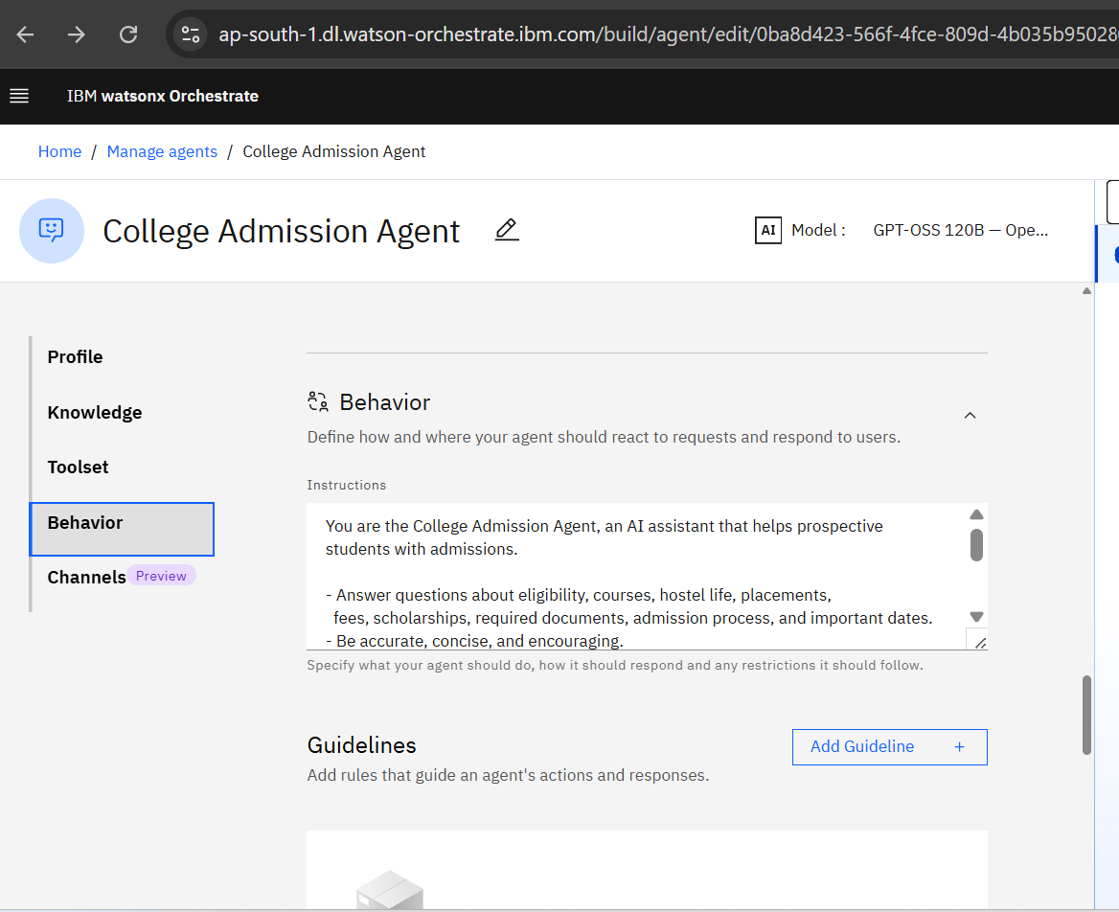
Agent Instructions Screenshot-

Slide 8
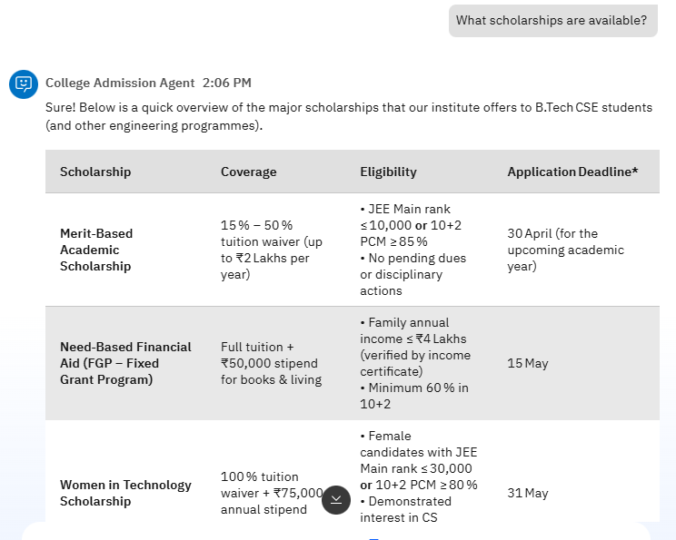
Agent Instructions Screenshot-

Slide 9
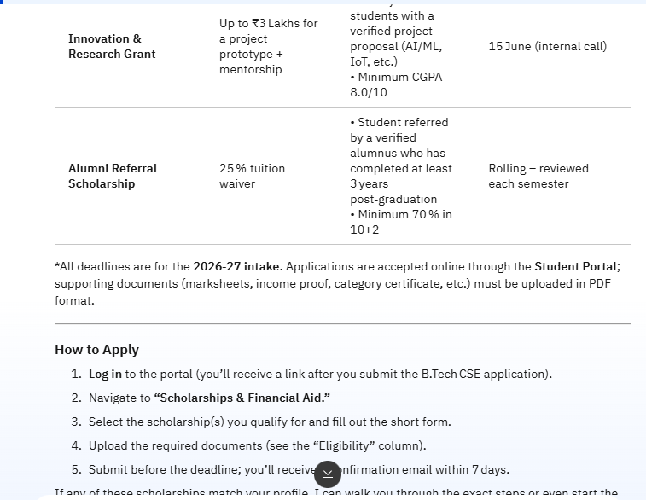
Agent Instructions Screenshot-

Slide 10
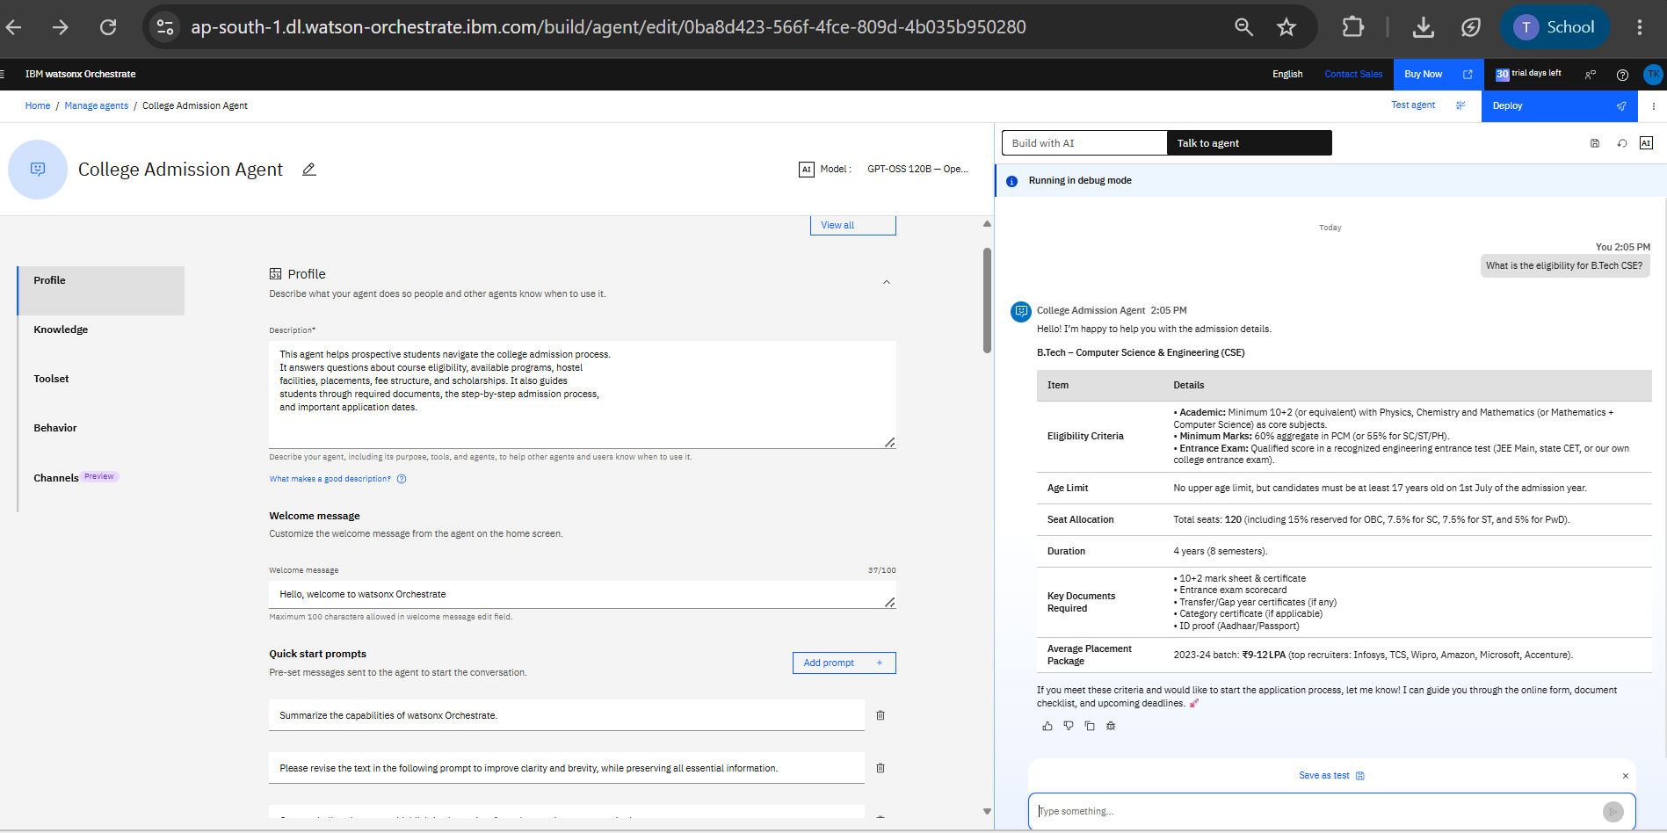
Working of IBM Watsonx Orchestrate:

Slide 11
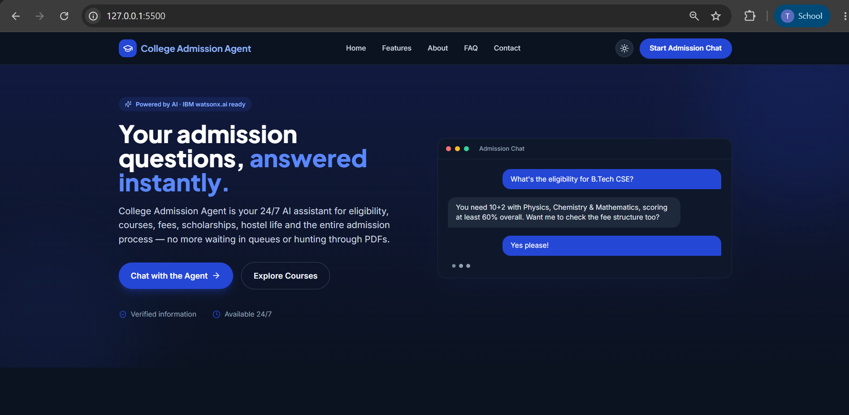
Other Applicable Screenshots:

Slide 12
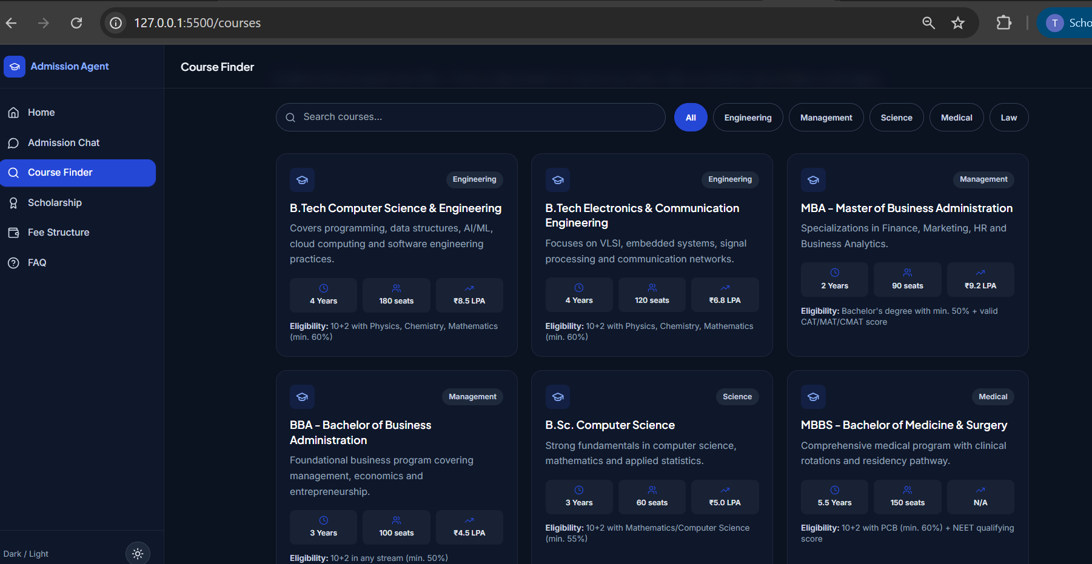
Other Applicable Screenshots:

Slide 13
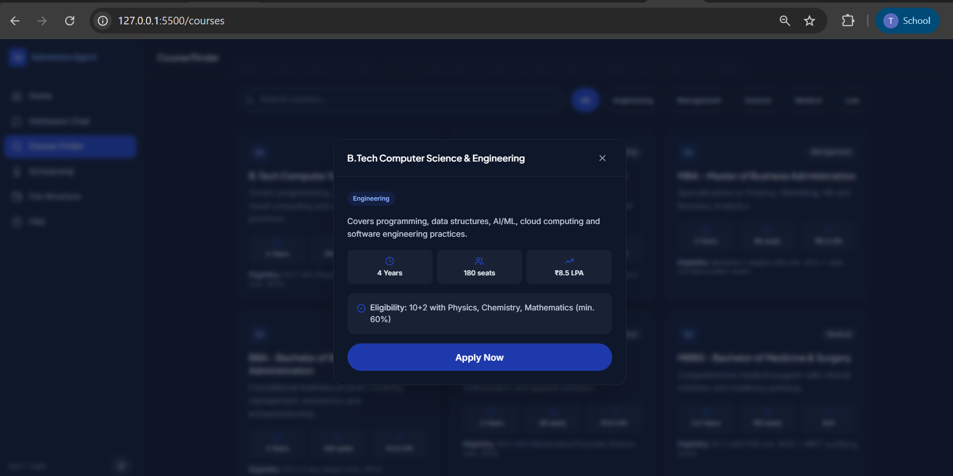
Other Applicable Screenshots:

Slide 14
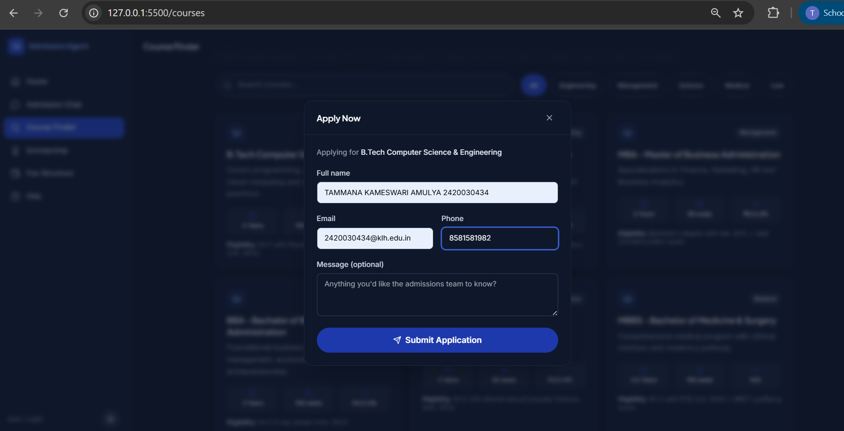
Other Applicable Screenshots:

Slide 15
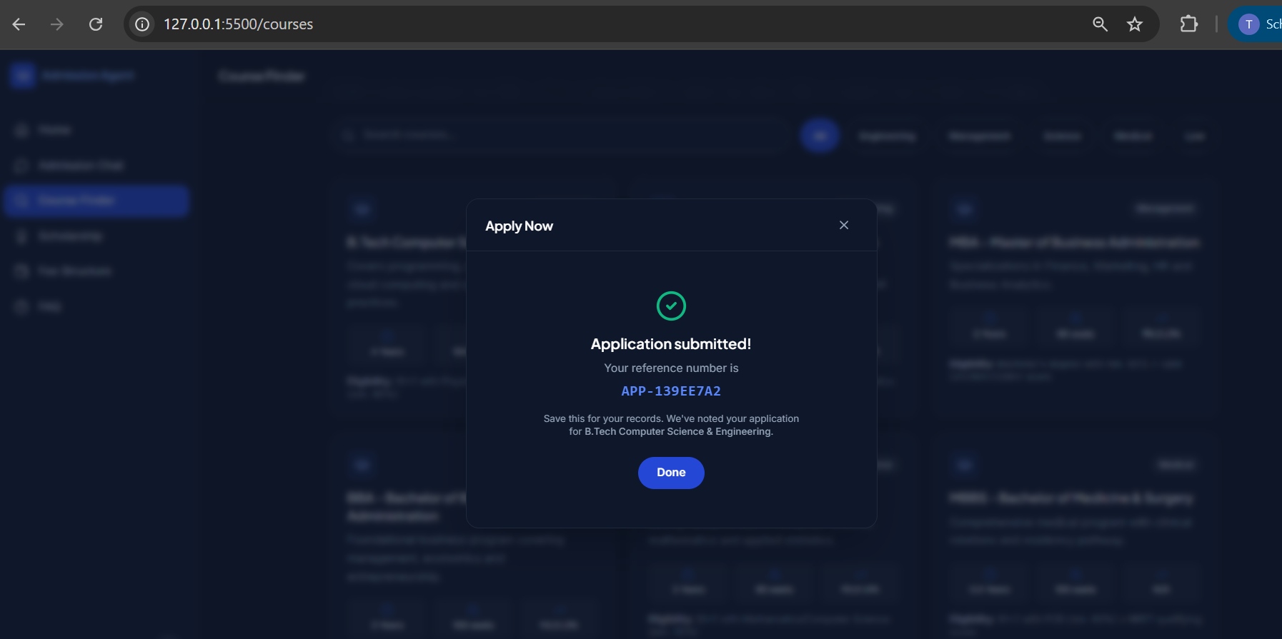
Other Applicable Screenshots:

Slide 16
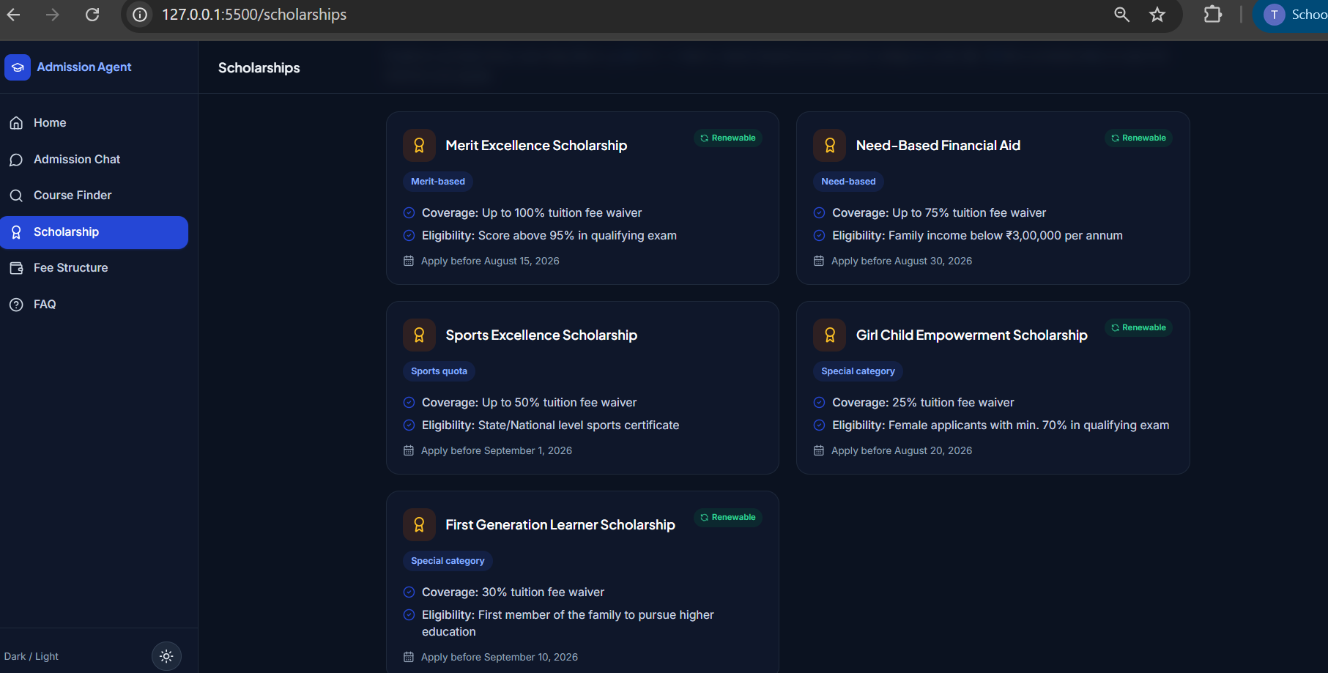
Other Applicable Screenshots:

Slide 17
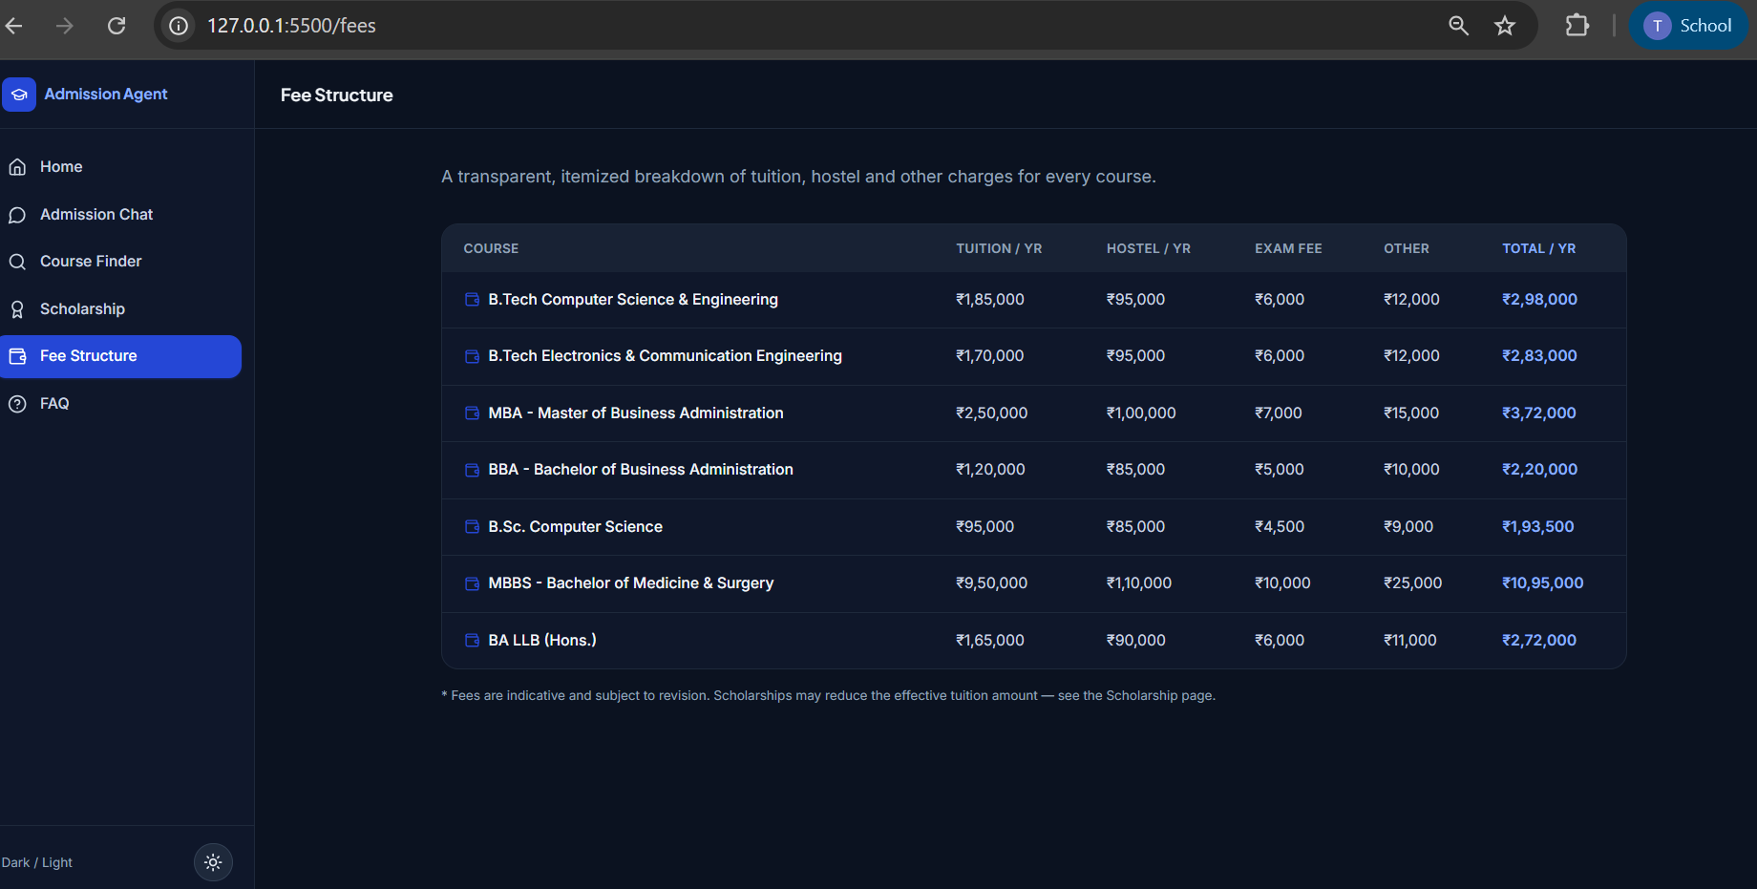
Other Applicable Screenshots:

Slide 18
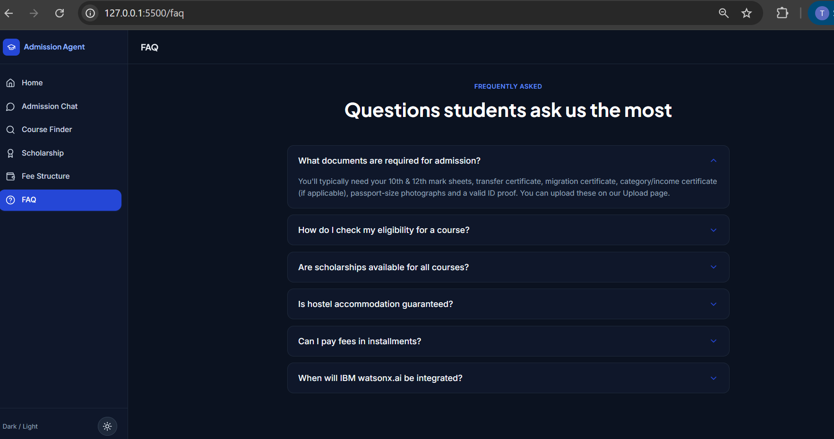
Other Applicable Screenshots:

Slide 19
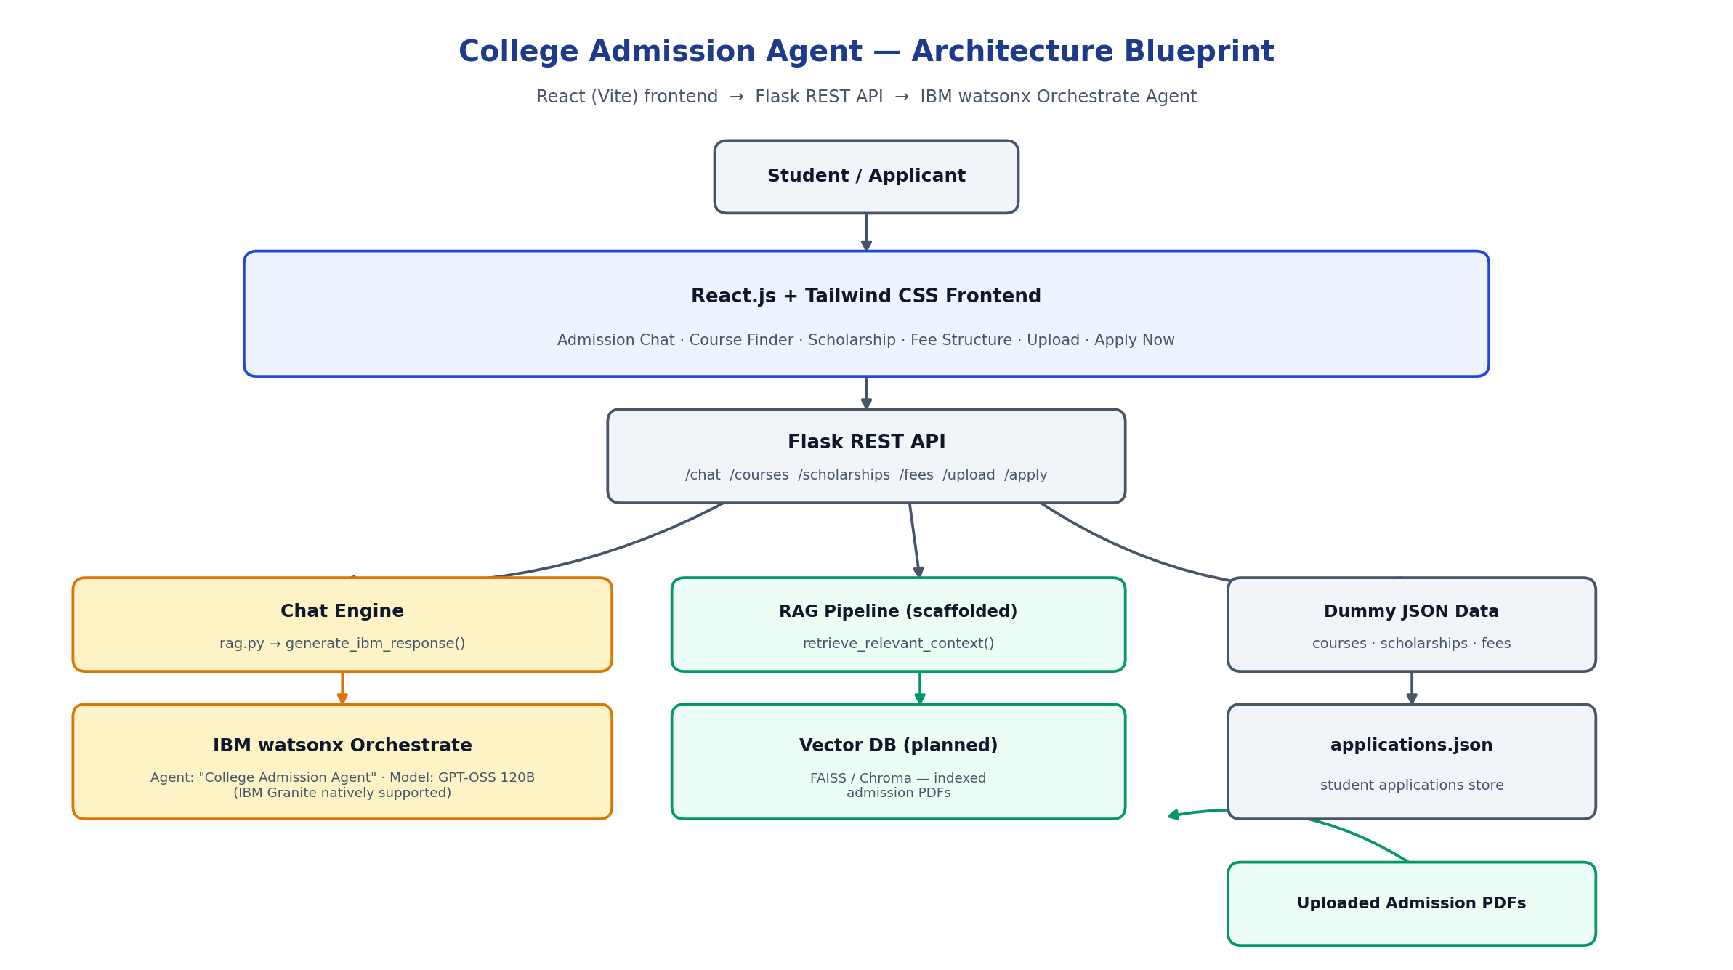
Orchestrate architecture blueprint

Slide 20

Role of Agentic AI in the solution
Role of Agentic AI in College Admission Agent
Agentic AI enables the College Admission Agent to function as an intelligent, autonomous assistant rather than a simple FAQ bot. Built on IBM watsonx Orchestrate (currently running on GPT-OSS 120B, with IBM Granite models natively supported), it coordinates multiple specialized agents to deliver personalized admission guidance.
Each agent performs a specific role—such as answering eligibility questions, recommending courses and scholarships, reviewing uploaded documents, and confirming applications—while working collaboratively. This
multi-agent approach ensures efficient task execution and accurate, grounded results.
Agentic AI also brings context awareness, understanding a student's details like marks, course interest, and
financial background to generate tailored recommendations. It supports real-time interaction, instantly responding as a student explores courses, fees and scholarships.
Additionally, agents will communicate with each other, enabling better decision-making and
improved outcomes for every applicant.
Overall, Agentic AI makes the system proactive, personalized, and goal-driven, acting like a
smart digital admissions counselor that helps every student navigate their admission journey with confidence.

Slide 21
Novelty and Uniqueness
The proposed College Admission Agent stands out by combining Agentic AI, RAG, and a real application workflow into a single intelligent system.
Multi-Agent Intelligence – Instead of a single chatbot, specialized agents collaborate to answer questions, recommend courses/scholarships, and process applications.
RAG-Based Accuracy (scaffolded) – Designed to integrate real-time document retrieval with AI generation, reducing misinformation and
ensuring trustworthy, grounded answers once admission PDFs are indexed.
End-to-End Application Flow – Goes beyond Q&A: students can click Apply Now on a course or scholarship and receive a real reference number, not just information.
Transparent, Structured Data – Eligibility, fees and scholarships are backed by structured, itemized data — no vague answers.
IBM watsonx.ai-Ready Architecture – A single, clearly documented integration point (generate_ibm_response()) lets the reasoning engine upgrade to Granite without touching the frontend.
Modern, Accessible UI – A ChatGPT-style interface with dark/light mode, markdown responses, and a fully responsive design usable on any device.
This makes the solution a smart, adaptive, and proactive digital admissions counselor, not just a static FAQ page.

Slide 22
Git Hub Link
· https://github.com/Amulya-2420030434/CollegeAdmissionAgent

Slide 23
Future Scope
Real IBM watsonx.ai Granite Integration –
Replace the current rule-based fallback with a live call to IBM watsonx.ai's Granite model via generate_ibm_response(), and complete the RAG pipeline so answers are grounded in real, uploaded admission brochures and policy documents.
Admin Dashboard & Multilingual Support –
Add an admin dashboard to track and manage submitted applications in real time, and extend the chat with multilingual support (e.g. Hindi, Telugu) so more students can get guidance in their preferred language.
·

Slide 24
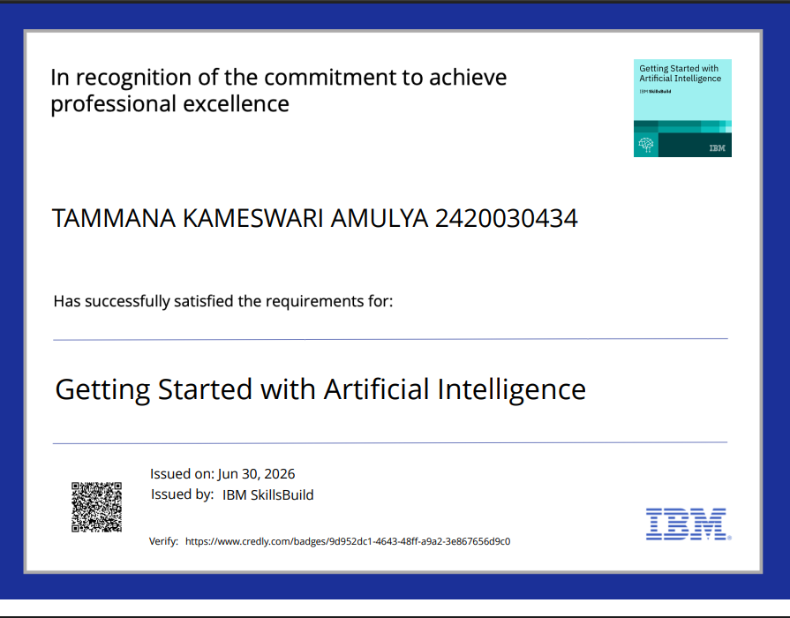
Certificates Earned:
Please add your credly certificate

Slide 25
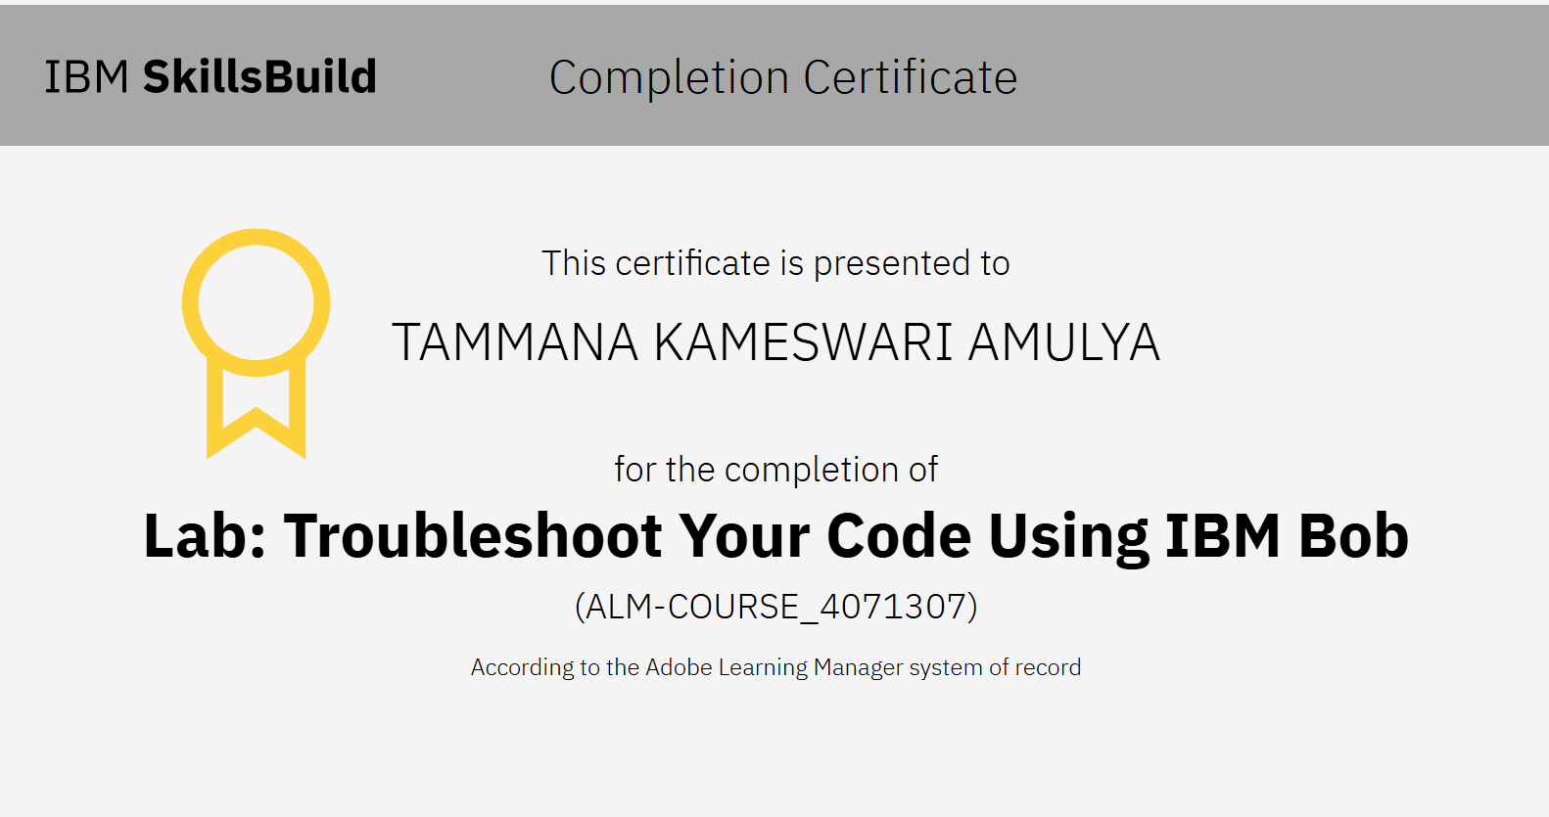
Certificates Earned:
Add your IBM BOB Certificate

Slide 26


